Slide 1
Genome Sciences 373 Genome Informatics
Quiz Section #1
March 31, 2015

Slide 2
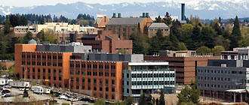
About me, course logistics, etc.
Matthew’s contact info
Email: mwsnyder@uw.edu
Phone: 206-685-3720
Office hours: Mondays 2:00-3:00pm
Foege building, room S110
…or by appointment

Slide 3
About me, course logistics, etc.
Homework policy:
No late homework accepted without PRIOR arrangements
Grading is equally about your effort and your execution
First homework assigned tomorrow

Slide 4
About me, course logistics, etc.
What is the quiz section all about?
not a “how-to” homework session
mostly we will learn Python and review in-class material
attendance is not required, but the material covered in section is required

Slide 5
Questions about course logistics?

Slide 6
What is an algorithm?
Formally: an exact procedure, or set of instructions, to achieve a predictable final result from a given input
Colloquially: a thorough method for solving a problem according to step-by-step instructions

Slide 7
Some key features of algorithms
Typically written in “pseudocode” or similar
Inputs and outputs specified at the outset
Often designed to achieve some goal in the “best” way possible
fastest
least memory
most accurate

Slide 8
Example of an algorithm: smallest number
Find the smallest of three numbers
Algorithm FindSmallestNumber
Input: three numbers A, B, and C
Output: the largest number

Slide 9
Example of an algorithm: smallest number
Find the smallest of three numbers
Algorithm FindSmallestNumber
Input: three numbers A, B, and C
Output: the largest number
current_smallest ← A
if B < current_smallest:
current_smallest ← B
else:
[do nothing]
if C < current_smallest:
current_smallest ← C [… else: do nothing]
return current_smallest
Notes:
arrow: means “store” or “assign” – assign the value of “A” to “current_smallest”

Slide 10
Example of an algorithm: smallest number
Find the smallest of three numbers
Algorithm FindSmallestNumber
Input: three numbers A, B, and C
Output: the largest number
current_smallest ← A
if B < current_smallest:
current_smallest ← B
else:
[do nothing]
if C < current_smallest:
current_smallest ← C [… else: do nothing]
return current_smallest
Notes:
return: this stops the algorithm and outputs the value.
Can we be guaranteed that we get a result?
What if we have ties? how could we extend this to allow for ties?

Slide 11
Another example: Euclid’s algorithm
Find the greatest common divisor of two numbers
If A > B, and A & B have greatest common divisor G, then G is also the GCD of A and (A – B)
Example: A = 63, B = 18
What is the GCD?
Can we generalize this process as a set of rules or steps to follow to ALWAYS find the GCD?
Notes:
63 – 18 = 45
45 – 18 = 27
27 – 18 = 9

Slide 12
Another example: Euclid’s algorithm
Find the greatest common divisor of two numbers
Algorithm EuclidGCD
Input: two numbers: A and B
Output: the GCD of A and B

Slide 13
Another example: Euclid’s algorithm
Find the greatest common divisor of two numbers
Algorithm EuclidGCD
Input: two numbers: A and B
Output: the GCD of A and B
start:
if B = 0 then output A (else: keep going)
if A > B then A ← A – B
else B ← B – A
go to start

Slide 14
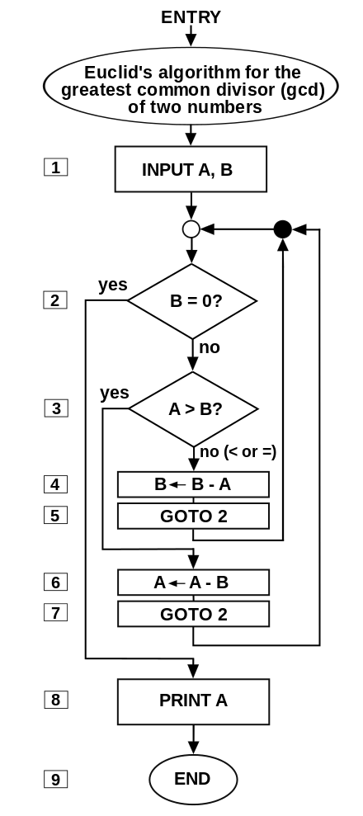
Often we can draw an algorithm as a flowchart
What’s the problem with this flowchart?
How could we improve it?
Source: http://en.wikipedia.org/wiki/Algorithm#/media/File:Euclid_flowchart.svg
Notes:
what happens if A is 0?

Slide 15
Common pitfalls and issues to consider
What if I enter a zero?
What if I enter a negative number?
What if I enter a fraction?
Is my algorithm guaranteed to ever finish?

Slide 16
In class example: algorithm for factorial
Recall: for any positive integer k,
k! = k * (k -1) * (k-2) * … * 1
What is an algorithm for calculating the factorial?

Slide 17
Algorithms are not the same as computer code!
But, algorithms can be implemented in programming languages
You have already done hard work!

Slide 19
Why do we program?
Get Stuff Done.
Automate repeated tasks
Extract information from huge amounts of data
Manipulate or convert data to get it in the right format

Slide 20
What tools do we need to write a program?
Technical stuff
Important stuff
Variables
Flow control
Syntax
Grammar
Patience
Practice
Comments
Internet

Slide 21
What tools do we need to write a program?
Technical stuff
Important stuff
Practical stuff
Variables
Flow control
Syntax
Grammar
Patience
Practice
Comments
Internet
Editor
Interpreter
Today: focus on editor & interpreter

Slide 22
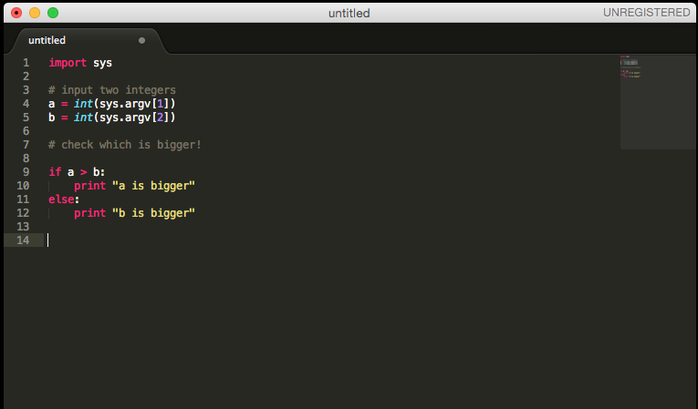
Python Editors: too many choices!
SublimeText: http://www.sublimetext.com/
PyCharm: https://www.jetbrains.com/pycharm/download/

Slide 23
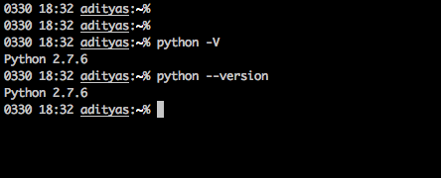
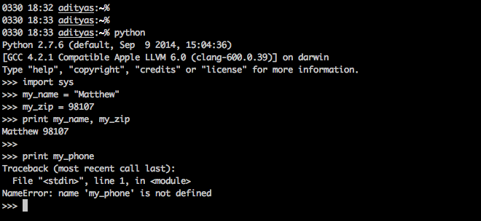
The Python Interpreter
Typing your script line-by-line: not a good plan

Slide 24
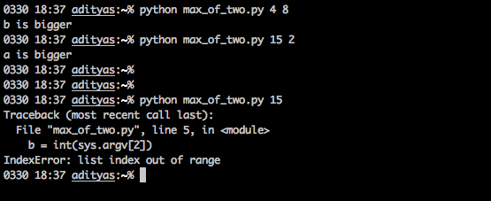
The Python Interpreter
Write your script in an editor, and then “call” it or “run” it from the command line

Slide 25
In-class example: Hello, world!

Slide 26
And now, a few comments about comments

Slide 27
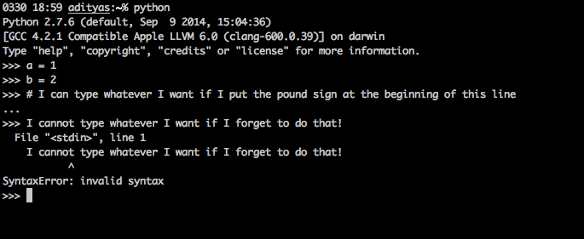
What is a comment in code?
A comment is a line, or part of a line, that is skipped by the interpreter.
In other words, it’s not interpreted. It’s just there.
In python, comments start with the pound sign (“#”)

Slide 28
Why do we comment our code?
Help yourself remember what you were thinking
Help other people understand what you were thinking
Help your grader figure out what you were trying to do, and what went wrong!

Slide 29
Commenting for beginners
Your homework MUST HAVE COMMENTS
It’s OK to “over-comment”
Usually you put comments just above / before the part of the program you’re referring to

